Slide 1
Citizenship in the Community
Troop 344 and 9344
Pemberville, OH

Slide 2
Citizenship in the Community Merit Badge Requirements
Discuss with your counselor what citizenship in the community means and what it takes to be a good citizen in your community. Discuss the rights, duties, and obligations of citizenship, and explain how you can demonstrate good citizenship in your community, Scouting unit, place of worship, or school.
Do the following:
On a map of your community or using an electronic device, locate and point out the following:
Chief government buildings such as your city hall, county courthouse, and public works/services facility
Fire station, police station, and hospital nearest your home
Parks, playgrounds, recreation areas, and trails
Historical or other interesting points of interest
Chart the organization of your local or state government. Show the top offices and tell whether they are elected or appointed.

Slide 3
Citizenship in the Community Merit Badge Requirements
Do the following:
Attend a meeting of your city, town, or county council or school board; OR a municipal; county, or state court session.
Choose one of the issues discussed at the meeting where a difference of opinions was expressed, and explain to your counselor why you agree with one opinion more than you do another one.
Choose an issue that is important to the citizens of your community; then do the following:
Find out which branch of local government is responsible for this issue.
With your counselor's and a parent's approval, interview one person from the branch of government you identified in requirement 4a. Ask what is being done about this issue and how young people can help.
Share what you have learned with your counselor.

Slide 4
Citizenship in the Community Merit Badge Requirements
With the approval of your counselor and a parent, watch a movie that shows how the actions of one individual or group of individuals can have a positive effect on a community. Discuss with your counselor what you learned from the movie about what it means to be a valuable and concerned member of the community.
List some of the services (such as the library, recreation center, public transportation, and public safety) your community provides that are funded by taxpayers. Tell your counselor why these services are important to your community.

Slide 5
Citizenship in the Community Merit Badge Requirements
Do the following:
Identify three charitable organizations outside of Scouting that interest you and bring people in your community together to work for the good of your community.
Pick ONE of the organizations you chose for requirement 7a. Using a variety of resources (including newspapers, fliers and other literature, the Internet, volunteers, and employees of the organization), find out more about this organization.
With your counselor's and your parent's approval, contact the organization you chose for requirement 7b and find out what young people can do to help. While working on this merit badge, volunteer at least eight hours of your time for the organization. After your volunteer experience is over, discuss what you have learned with your counselor.
Develop a public presentation (such as a video, slide show, speech, digital presentation, or photo exhibit) about important and unique aspects of your community. Include information about the history, cultures, and ethnic groups of your community; its best features and popular places where people gather; and the challenges it faces. Stage your presentation in front of your merit badge counselor or a group, such as your patrol or a class at school.

Slide 6
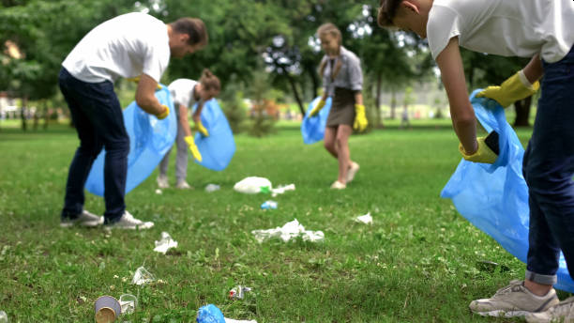
Requirement 1
Discuss with your counselor what citizenship in the community means and what it takes to be a good citizen in your community. Discuss the rights, duties, and obligations of citizenship, and explain how you can demonstrate good citizenship in your community, Scouting unit, place of worship, or school.

Slide 7
Citizenship in the Community
What is a community?
A community is a group of people living in a particular area who share:
Common characteristics.
Interests.
Activities.
Purposes.
Group can be as small as a family living together in an apartments.
Group can be as large as a population of a sprawling metropolitan area.

Slide 8
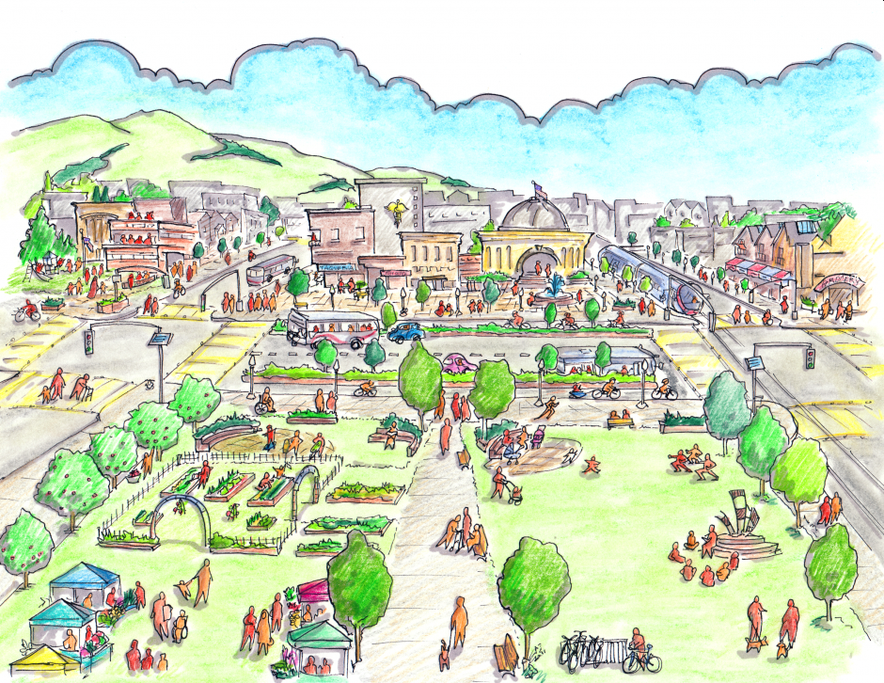
Citizenship in the Community
Communities within Communities
The United States is a patchwork of communities.
Family
Neighborhood
School
Scout troop
Club
Team
Worship group
City

Slide 9
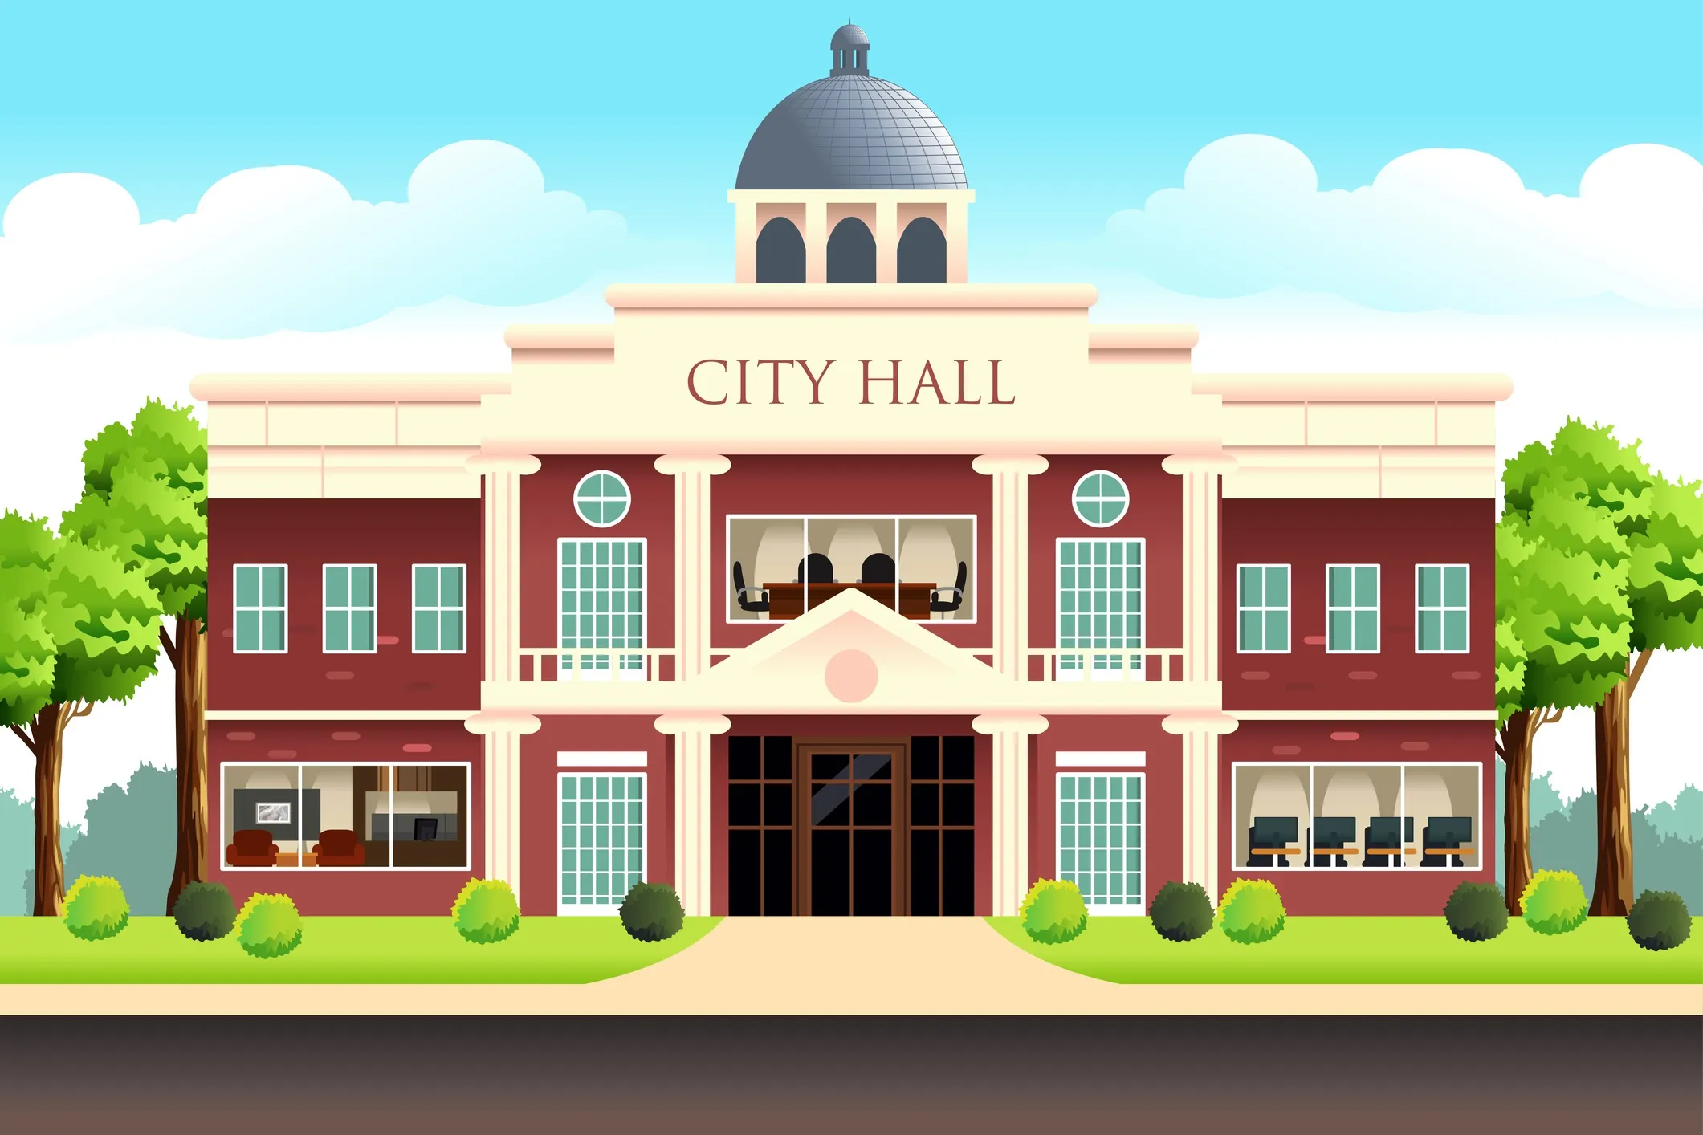
Citizenship in the Community
Self-Governance
In the US, Citizens help make decisions about their community.
Elect local officials.

Slide 10
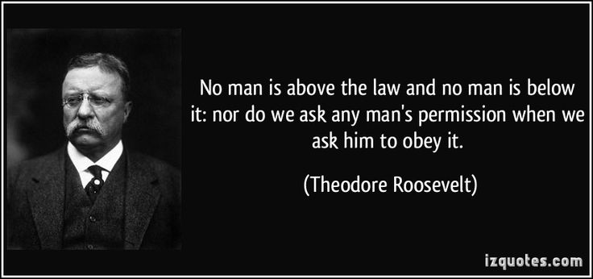
Rights, Duties, Obligations
Rights, Duties, and Obligations of an American Citizen
Rights:
Freedoms guaranteed by the US Constitution.
Full protection from Federal, state, and local laws.
Support from local service departments (fire, police, sanitation).
Duties, and Obligations:
Pay Taxes.
Obeying the law.
Value others’ opinions.
Staying informed about candidates and issues.
Respecting elected officials.

Slide 11
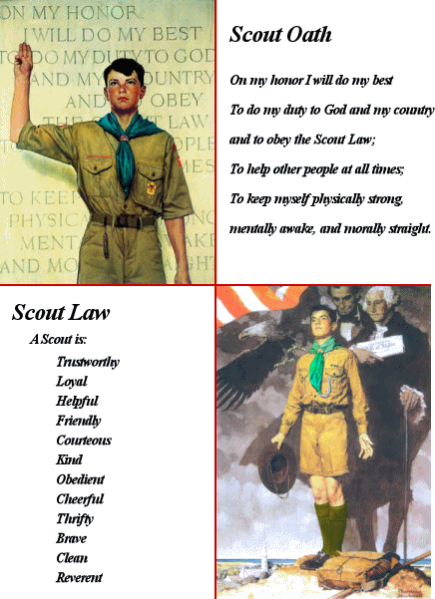
Demonstrating Citizenship
Rights, Duties, and Obligations – Scout Unit
Rights:
Express your opinions.
Try new skills.
Hang out with friends.
Be safe.
Duties, and Obligations:
Honor your parents.
Respect adult leaders.
Respect fellow scouts.
Help one another.
Follow the rules.

Slide 12
Demonstrating Citizenship
Rights, Duties, and Obligations – Place of Worship
What are your rights?
?
?
?
?
What are your duties, and obligations
?
?
?
?

Slide 13
Demonstrating Citizenship
Rights, Duties, and Obligations – School
What are your rights?
?
?
?
?
What are your duties, and obligations
?
?
?
?

Slide 14
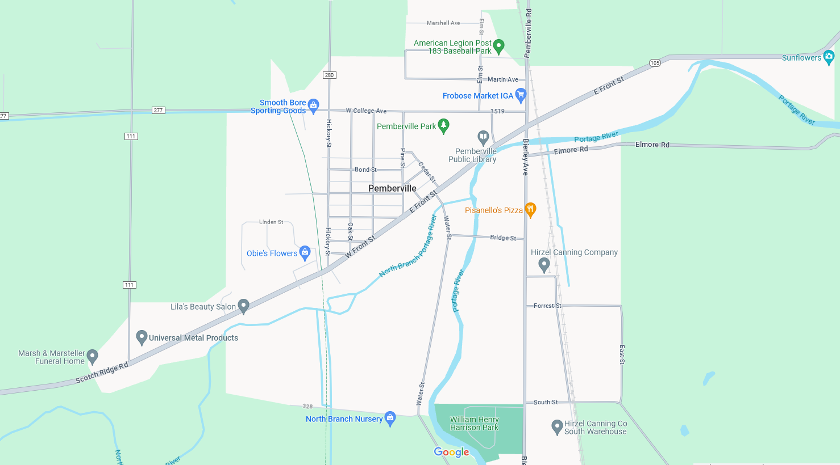
Requirement 2
Do the following:
On a map of your community or using an electronic device, locate and point out the following:
Chief government buildings such as your city hall, county courthouse, and public works/services facility.
Fire station, police station, and hospital nearest your home.
Parks, playgrounds, recreation areas, and trails.
Historical or other interesting points of interest.

Slide 15
Pemberville Government Buildings

Slide 16
Pemberville Parks and Recreation

Slide 17
Wood County Offices

Slide 18
Bowling Green Parks and Recreation

Slide 19
Area Historical Points of Interest

Slide 20
Requirement 2
Do the following:
Chart the organization of your local or state government. Show the top offices and tell whether they are elected or appointed.

Slide 24
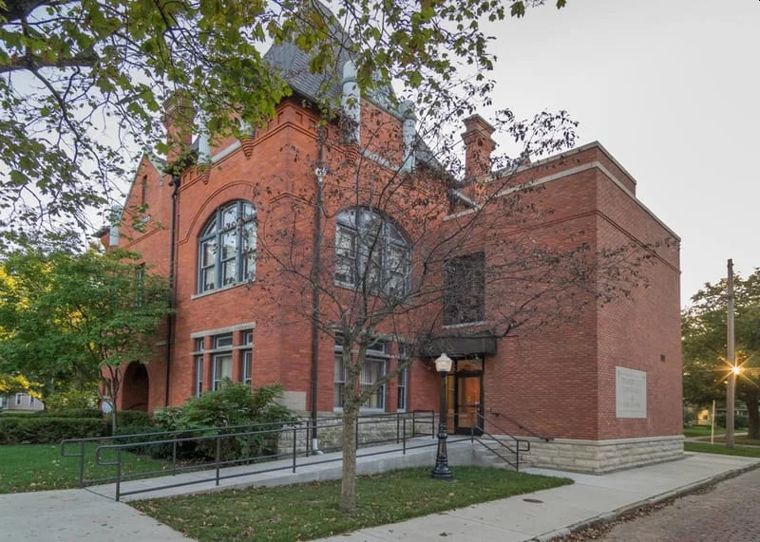
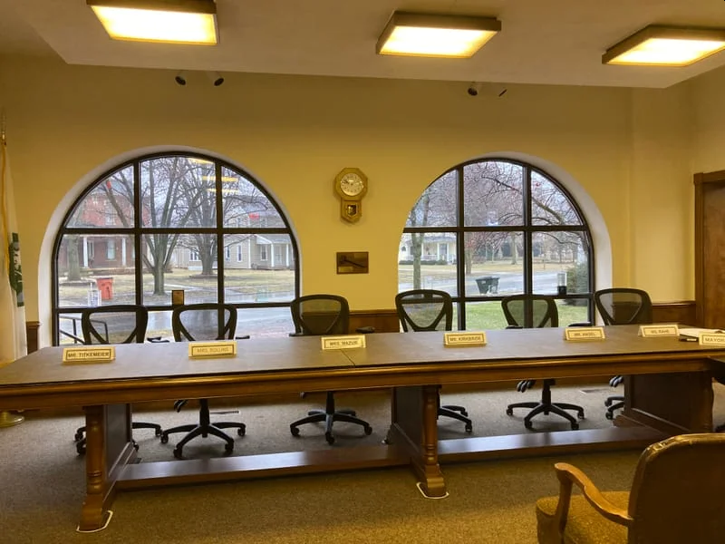
Requirement 3
Do the following:
Attend a meeting of your city, town, or county council or school board; OR a municipal; county, or state court session.

Slide 25
Pemberville Town Council
Council Meetings are held every 1st and 3rd Tuesday at 7:00PM
Village of Pemberville Offices 115 Main Street P.O. Box 109 Pemberville, OH 43450 419-287-3832

Slide 26
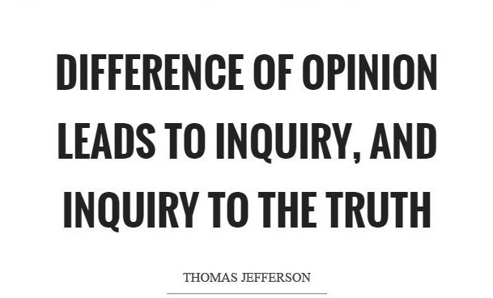
Requirement 3
Do the following:
Choose one of the issues discussed at the meeting where a difference of opinions was expressed, and explain to your counselor why you agree with one opinion more than you do another one.

Slide 27
Community Issue
Issue?
Differing opinions?
Your view?

Slide 28
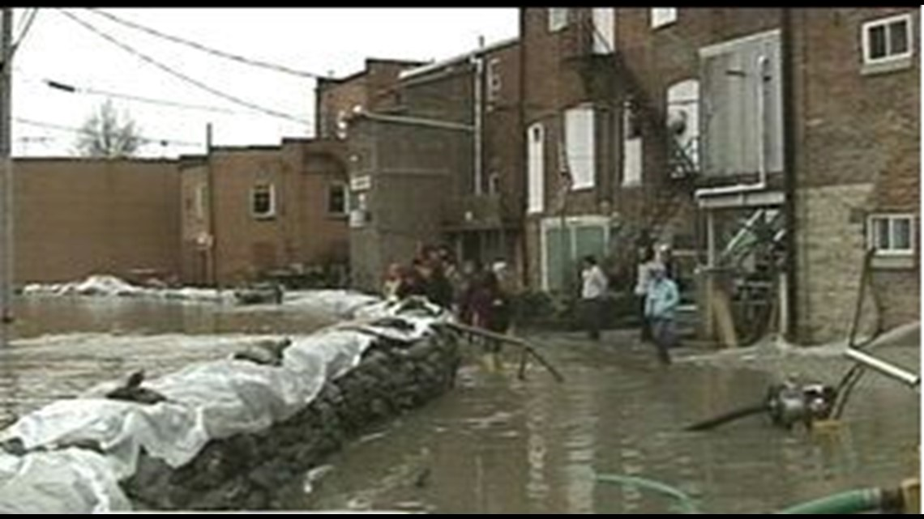
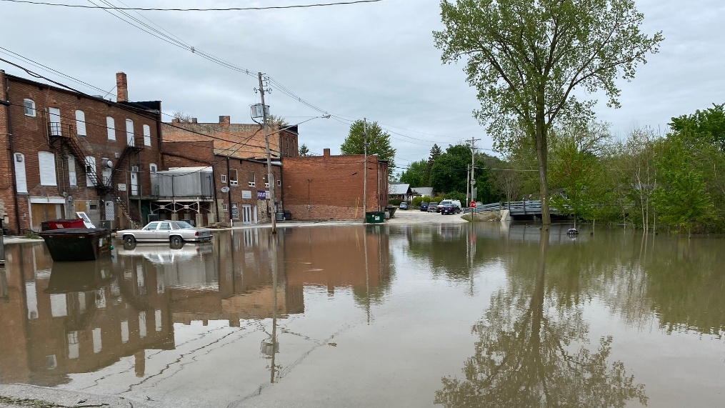
Requirement 4
Choose an issue that is important to the citizens of your community; then do the following:
Find out which branch of local government is responsible for this issue.
With your counselor's and a parent's approval, interview one person from the branch of government you identified in requirement 4a. Ask what is being done about this issue and how young people can help.
Share what you have learned with your counselor.

Slide 29
Community Issue
Issue important to community?
Who is responsible for this issue?
What is being done about this issue?
How can young people help?

Slide 30
Requirement 5
With the approval of your counselor and a parent, watch a movie that shows how the actions of one individual or group of individuals can have a positive effect on a community. Discuss with your counselor what you learned from the movie about what it means to be a valuable and concerned member of the community.

Slide 31
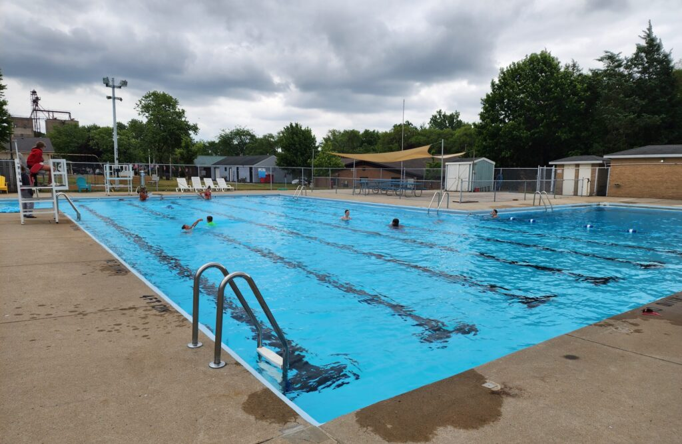
Requirement 6
List some of the services (such as the library, recreation center, public transportation, and public safety) your community provides that are funded by taxpayers. Tell your counselor why these services are important to your community.

Slide 32
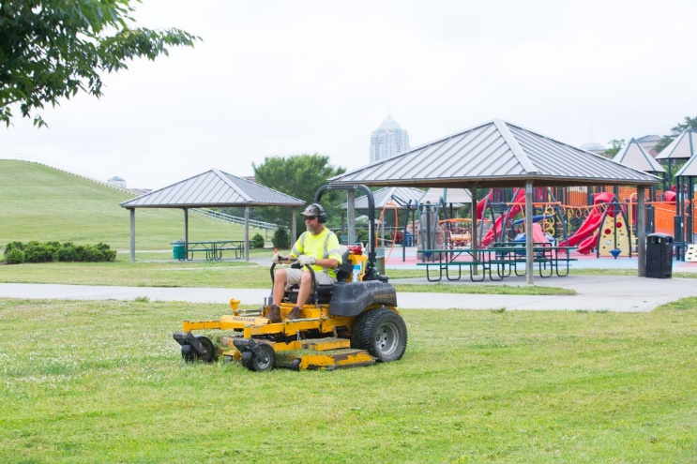
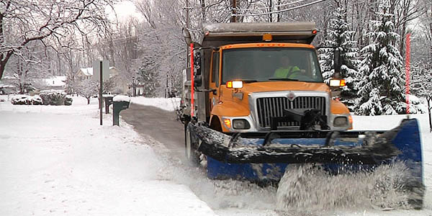
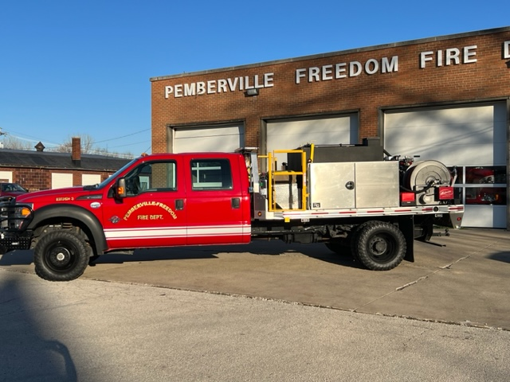
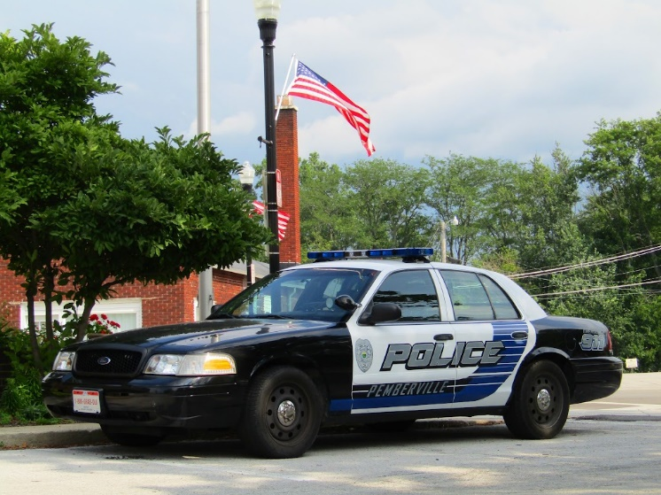
What are some taxpayer supported community services?

Slide 33
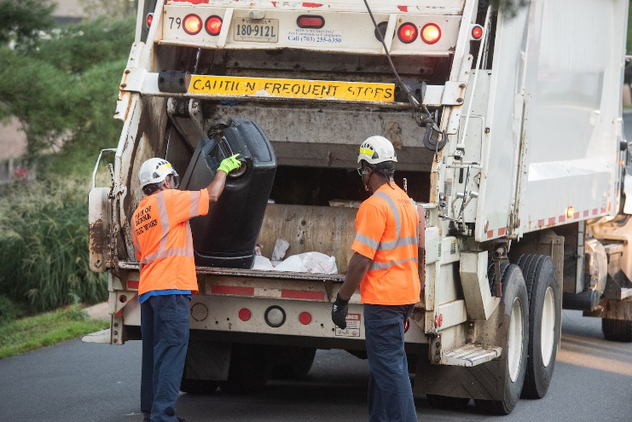
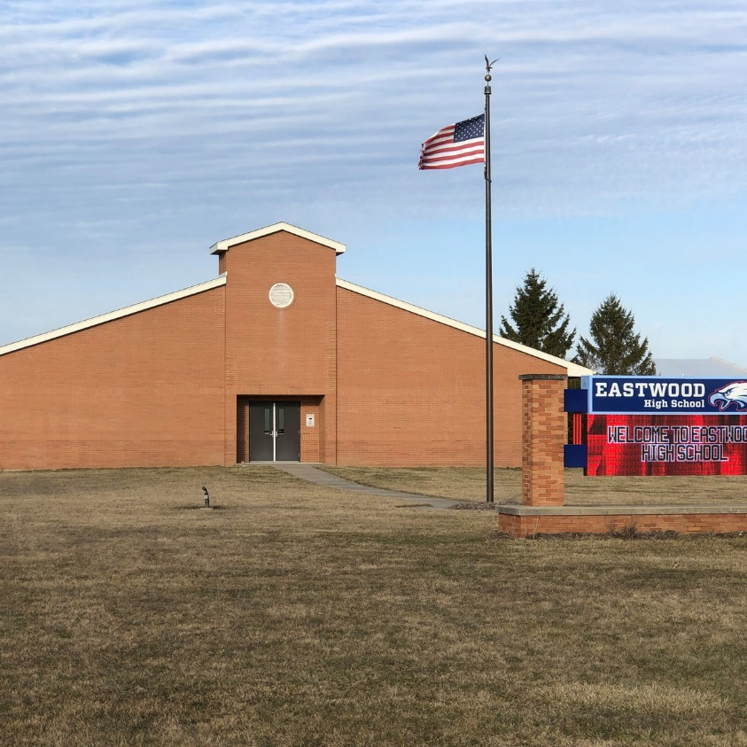
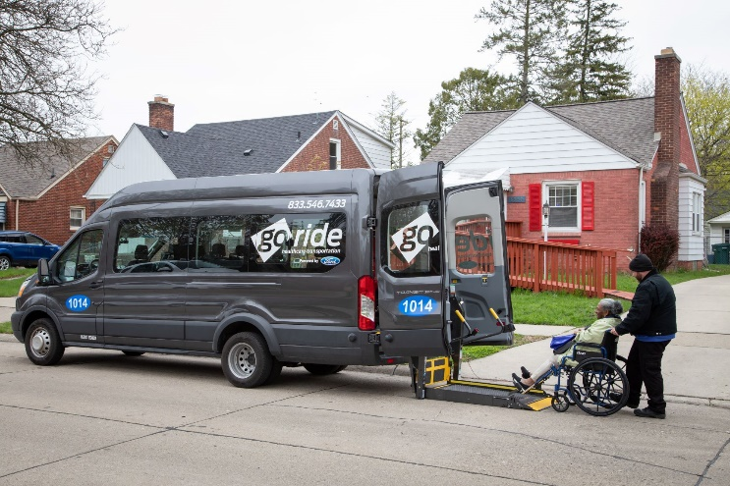
Why are these services important to the community?

Slide 34
Requirement 7
Do the following:
Identify three charitable organizations outside of Scouting that interest you and bring people in your community together to work for the good of your community.
Pick ONE of the organizations you chose for requirement 7a. Using a variety of resources (including newspapers, fliers and other literature, the Internet, volunteers, and employees of the organization), find out more about this organization.
With your counselor's and your parent's approval, contact the organization you chose for requirement 7b and find out what young people can do to help. While working on this merit badge, volunteer at least eight hours of your time for the organization. After your volunteer experience is over, discuss what you have learned with your counselor.

Slide 35
Identify three charitable organizations:
Charities near Bowling Green, OH.
Pick one and find out more about this organization.

Slide 36
Contact information and volunteer opportunities for your organization?
These hours can also be used for rank advancement!

Slide 37
What did you learn by volunteering for this organization?

Slide 38
Benefits of Volunteering
Provides you with a sense of purpose
You may be able to find your purpose through volunteering and becoming part of something greater than yourself. For instance, if you’re retired, unexpectedly unemployed or have lost a loved one, helping others can give your life new meaning and keep you mentally stimulated.
Provides a sense of community
Volunteering can help you feel connected to those you are helping in the community. This experience may make you want to get involved with other aspects of your community, such as local politics or advocating for programs you believe are important.

Slide 39
Benefits of Volunteering
Helps you meet new friends
Volunteering is a great way to meet new friends as well as strengthen existing connections with friends, family or coworkers. As a volunteer, you’ll typically interact with people from diverse backgrounds, which allows you to learn other perspectives.
When you choose an organization or cause to volunteer for, consider the people you’re volunteering alongside did as well. Sharing a common interest will help you build closer relationships with those around you.
Increases your social skills
Volunteering gives you a chance to talk to new people and sharpen your social skills. By spending a lot of time working with others and using social skills, like active listening and relationship management, you’ll have the opportunity to develop your future personal and business relationships.

Slide 40
Benefits of Volunteering
Improves self-esteem
Volunteering may boost your self-esteem and self-confidence. When you do something you feel is worthwhile and valuable for your community, it gives you a sense of accomplishment that may help you feel more fulfilled about your life and any future goals.
Teaches you valuable skills
The training and hands-on experience you gain while volunteering can help you learn new skills as well as build upon ones you already have. For example, if you advocate and raise awareness or funding for a cause that interests you, you’ll gain valuable communication, public speaking, marketing and other hard and soft skills. You can then put these skills on your resume to show employers how you build relationships outside of work in addition to any personal interests that can set you apart from other candidates.

Slide 41
Benefits of Volunteering
Provides job prospects
Along with acquiring valuable skills and experience, you may also meet people while volunteering who can become your mentors or at least a part of your professional social network. If you choose to pursue a career in the field you’re volunteering in, the connections you make also may help increase your job prospects.
Brings fun into your life
Many people use volunteering as a way to pursue their hobbies while making a difference. For example, if you’re interested in the outdoors, you might volunteer at your community garden or help out at a children's summer camp. Volunteering for organizations or causes also may provide you with a renewed sense of creativity and motivation that carries over into your personal and professional life.

Slide 42
Benefits of Volunteering
Can help you be happier
It often feels good to contribute to projects and organizations that mean something to you. These good feelings can help lessen the effects of stress, anger or anxiety in your life. Volunteering may provide you with the tools you need to be a happy and well-rounded individual. Building bonds and connections with people you volunteer with also may counteract any social isolation. Many volunteer opportunities also may involve physical labor to keep you active and reduce stress.

Slide 43
Benefits of Volunteering
Gets you out of your comfort zone
Through volunteer work, you may overcome the personal challenges of leaving your comfort zone and doing something new with people you may not know. You may be faced with various problems to solve as a volunteer that require you to exercise critical thinking skills that aid your own personal development.

Slide 44
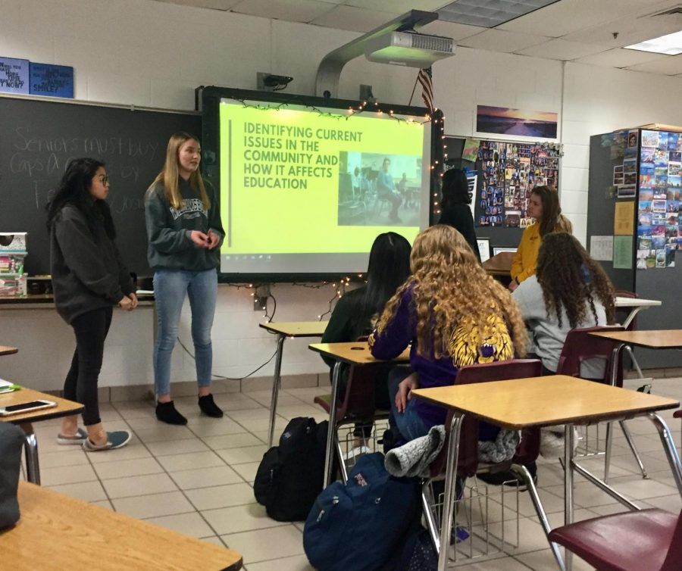
Requirement 8
Develop a public presentation (such as a video, slide show, speech, digital presentation, or photo exhibit) about important and unique aspects of your community. Include information about the history, cultures, and ethnic groups of your community; its best features and popular places where people gather; and the challenges it faces. Stage your presentation in front of your merit badge counselor or a group, such as your patrol or a class at school.

Slide 45
Creative Presentation Ideas:
Develop a multimedia presentation slides (PowerPoint, or Google Slides) using video, audio, and visual elements. The entire presentation can be recorded and the video presentation can be shared with the appropriate audience.
Create an interactive website or blog to present the research or project.
Design an engaging infographic to illustrate key concepts.
Host a podcast episode or series related to the topic.
Collaborate with other scouts to create a short film or documentary.

